Slide 1
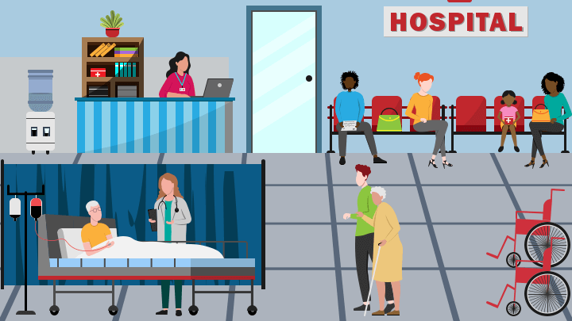
Hospital Room Simulation
Sree Sarada Alapaty
G#- G01440615
HAP 618- Fall 2023

Slide 2

Background:
In recent years, the integration of technology and medicine has resulted in notable progress in healthcare in the last few years. Medical research, data analysis, and the development of healthcare apps are among fields where technology- especially programming languages like python- has been extremely important. Python is a popular choice in the medical industry because of its ease of use, adaptability, and large library ecosystem.

Slide 3
Healthcare is a dynamic complex field that faces several obstacles daily.
Healthcare practitioners frequently have to balance the requirements of their patients, their limited resources, and the efficiency of the organization.
To put things in perspective, think about this: in the United States, patients typically wait more than 1 hour. Long wait times affect patient satisfaction and have a negative impact on health outcomes and the overall effectiveness of the healthcare system.

Slide 4

When we go to the hospital for check up, we end up in a waiting room full of dozens of others who also need care, which makes you think what solution can be implemented to reduce the wait time?

Slide 5

The average wait time for patients in United States is more than an hour. Patients who arrive at EDs with broken bones wait a painful 54 min, on avg, before receiving any pain meds.
So, what really driving the wait?
At any moment in time, the number of people who walk through the hospital door may be larger than the number of physicians available. When this happens, some patients must wait. It’s a matter of fact.
Of course, such waits could be reduced if the hospitals invests in additional beds, employs a surplus of physicians, and uses faster diagnostic technology. The problem with this solution is these costly resources will be sitting idle most of the time.

Slide 6
The mismatch between patient demand and healthcare professionals' availability is at the core of the problem.
One of the main causes of the difficulties we have talked about is shortage of physicians.
The lengthy wait times have wide range of negative effects, possibly endangering patient outcomes in addition to patient satisfaction. It’s a systemic issue that needs creative solutions to improve patient care efficiency.
To put it briefly, my project recognizes these difficulties and work to develop a solution that addresses the issues faced by both patients and healthcare providers.
This project seeks to improve patient care by cutting wait times and utilizing staff as efficiently as possible.

Slide 7
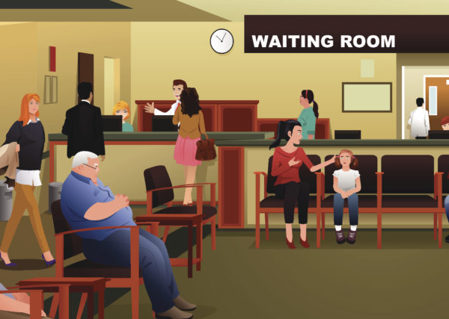
Using the available resources, I think that one method to reduce wait times is to employ the Python-based Pandas library to cut down the waiting period for patients who need medical care.

Slide 8
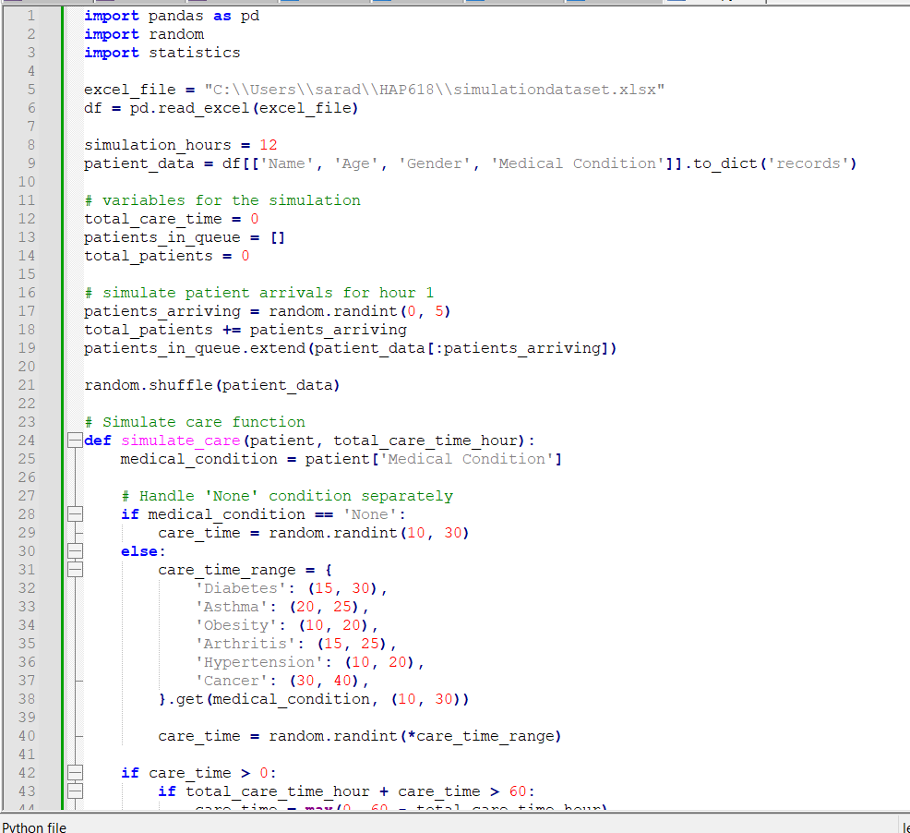
Here is the python code for the simulation.
Let’s go through the code and check what we are doing in the hospital room simulation and what we are expecting at the end of the simulation.

Slide 9
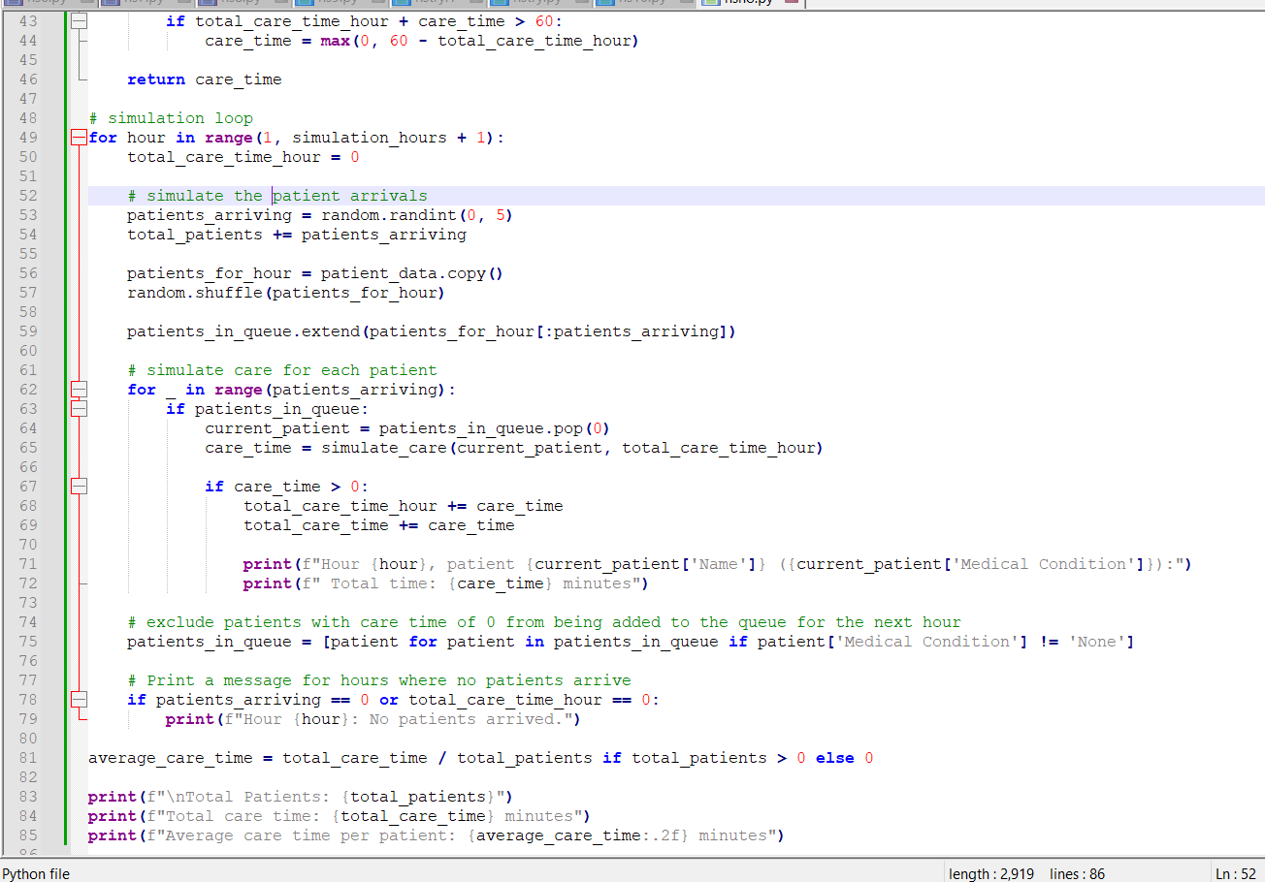

Slide 10
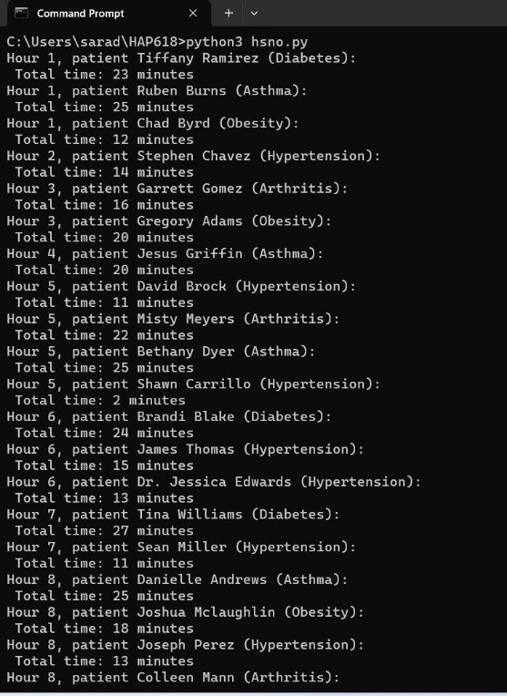
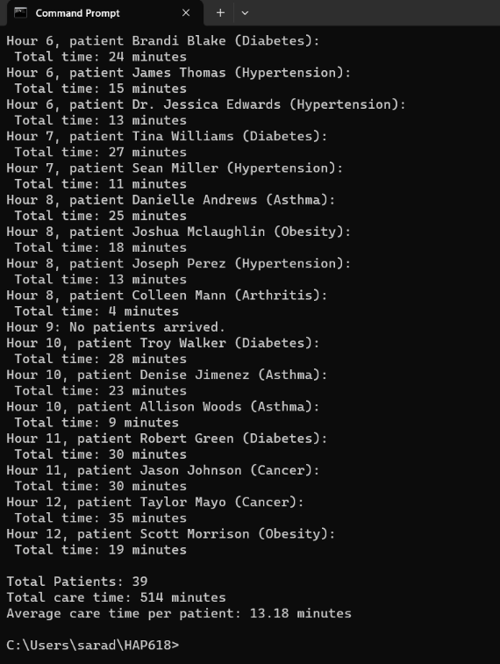
After executing the code, this is the output.

Slide 11
From this simulation we have got a comprehensive overview of a healthcare facility’s activity over a 12-hour period.
We have 39 patients visited and the respective time spent on their care in each hour and their medical conditions are mentioned.
Here, the total care time is 514 minutes, with an average care time per patient of 13.18 minutes.
All these values for the variables vary when we run the simulation each time.

Slide 12
A greater knowledge of patient demographics, common medical conditions, and the distribution of care time is made possible by this information.
As such, this simulation provides insightful information for workload evaluation, allowing healthcare organization to allocate resources optimally, pinpoint areas for development, and raise overall patient care management efficiency.

Slide 13
Conclusion:
In short, this Python script’s carefully constructed healthcare simulation shows how to simulate patient arrivals and care duration over a twelve-hour period in a comprehensive manner. The realistic portrayal of healthcare incidents is ensured by the hourly generation of patient lines in the simulation, which is based on randomized arrival of patient numbers and care patterns.

Slide 14
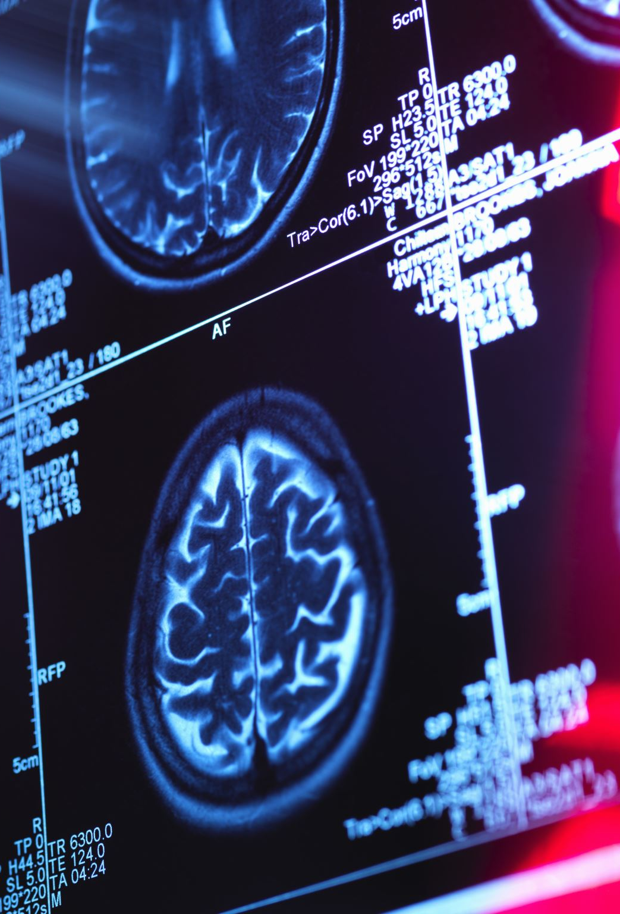
So, what’s future for this?
Machine learning algorithms might be included into the script as it develops to anticipate patient arrivals, identify trends in medical conditions, and enhance treatment plans.
The simulation is an effective tool for creating scenarios. It can be used by healthcare professionals to model a variety of situations, including unexpected patient surges or shifts in prevalence of specific conditions.
Enhancing the simulation’s realism and applicability could involve integrating it with EHR system. By enabling a more thorough simulation environment and facilitating a smooth flow of patient data, this interface can help close gap between hypothetical scenarios and real healthcare procedures.

Slide 15
Thank you

